Slide 1





Sentimental Analysis
On Images using AI Technique
Mishra Suraj
Panpatil Abhijeet
Shaikh Afrid

Slide 2
Abstract
Researchers have largely relied on textual sentiment analysis.
Recently, social media users are increasingly using images and videos to express their opinions and share their experiences.
Sentiment analysis of such large scale visual content can help better extract user sentiments toward events or topics, such as those in image.
In this project, we will make use of images which will be fed to machine learning/ AI model responsible for predicting emotion of user.

Slide 3
Literature Survey
During the 2012 presidential election, USA Today ran a daily feature in which its technology partner, Topsy (since acquired by Apple), provided a sentiment score for each candidate. On May 1st, the first day the feature ran, for instance, Barack Obama scored 34 and Mitt Romeny scored 26. On November 7th, the day after the election, Obama scored 85 and Romney scored 57.
- [Online] Available: https://www.fastcompany.com/3037915/the-problem-with-sentiment-analysis
If we search for a tag "love" on Flickr, we get a wide variety of images: roses, a mother holding her baby, images with hearts, etc. These images are very different from one another and yet depict the same emotion of “love” in them. In this project, we explore the possibility of using deep learning to predict the emotion depicted by an image. Our results look promising and indicate that neural nets are indeed capable of learning the emotion essayed by an image.
- “[Vasavi Gajarla, Aditi Gupta] : Emotion Detection and Sentiment Analysis of Images”

Slide 4
Significant relationships between personality traits and various features of images posted on social media.
“[Yoram Bachrach, Michal Kosinski, Thore Graepel, Pushmeet Kohli, David Stillwell] : Personality and Patterns of Facebook Usage”
Social media users are increasingly using images and videos to express their opinions and share their experiences. Sentiment analysis of such large scale visual content can help better extract user sentiments toward events or topics, such as those in image tweets, so that prediction of sentiment from visual content is complementary to textual sentiment analysis.
“[Stuti Jindal and Sanjay Singh](2015 International Conference on Information Processing (ICIP) IEEE) : Image Sentiment Analysis using Deep Convolutional Neural Networks with Domain Specific Fine Tuning ”

Slide 5
Problem Statement
Emotions can’t be faked
Millions of images posted on social media
Written reviews taken these days aren’t legitimate these days.
Emotions are quick reply to events that can’t be faked and provides true feedback
Model can be built to analysis images to predict emotion.

Slide 6
Proposed System
A machine learning/AI model will be responsible for taking images and giving emotion as output.
Images can be scraped from various websites.
Various machine learning models can be used like KNN(K nearest neighbors), SVM(Support vector machine), CNN (Convolutional neural network).
Various images of workforce can be taken to analyze interest of individual employee towards assigned work.

Slide 7
Data collection and Data preprocessing
Labeling images based on emotions
Image processing
Cropping images (human faces).
Gray scaling of images

Slide 8
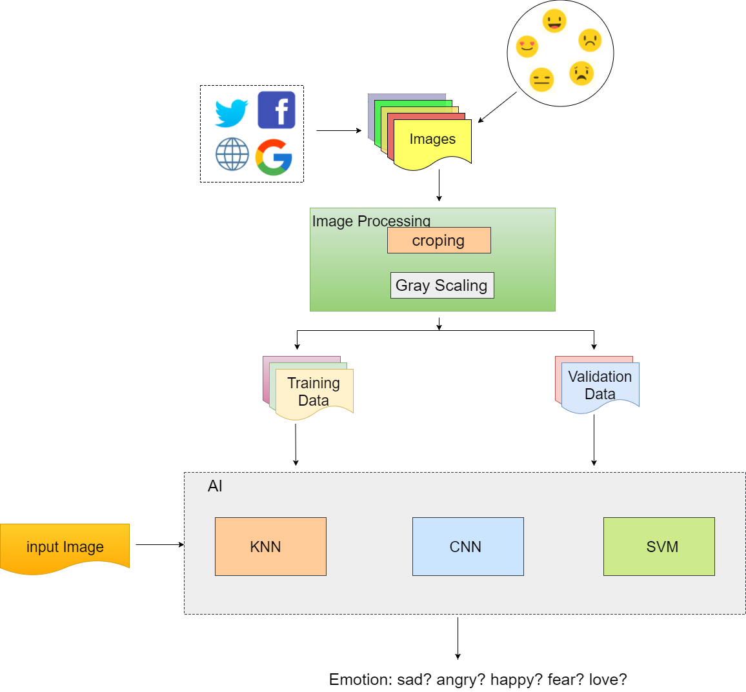

Slide 9
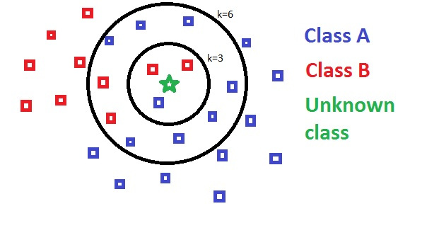
K-NN(K Nearest Neighbor)

Slide 10
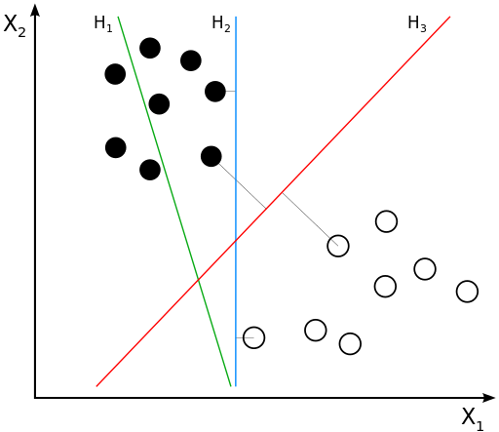
SVM (Support Vector Machine)

Slide 11
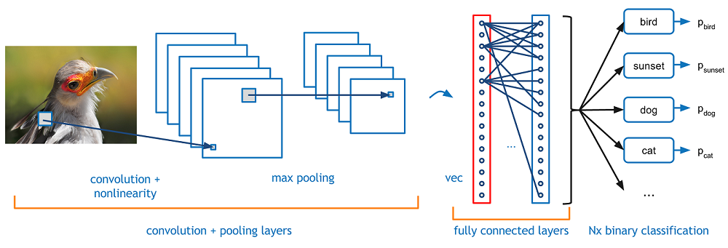
CNN (Convolution Neural Network)

Slide 12
Thank You!
Any Questions?

